Slide 1
Executable and Linkable Format (ELF)

Slide 2
Why Executable Formats?
All code in one file
But libraries!
We need a way to combine files
Distribute as binary (“object files”)
Linkers
We need a way to control how our programs run
Memory permissions
Loading addresses
Loaders
We want PIE code! And shared libraries!
Dynamic linker (ld.so)

Slide 3
Why Executable Formats?
Provide key metadata for running programs
Memory permissions
Loading addresses, custom interpreter, etc.
Provide debugging assistance
Debug symbols
Allow combining (linking) programs
Relocations
Function symbols

Slide 4
Common Executable Formats
Executable and Linkable Format (ELF)
Portable Executable (PE)
Mach object file format (Mach-O)
Organized Runtime Contents (ORC) - custom 595g file format!
Admittedly not so common...

Slide 5
How does ELF work?
Reference: http://www.skyfree.org/linux/references/ELF_Format.pdf
Will be posted at http://cs595g.lockshaw.io/w20.html
Your friend: readelf
readelf -S (sections)
readelf -l (segments) <- that’s a lowercase L
readelf -h (headers)
readelf -a (everything)

Slide 6
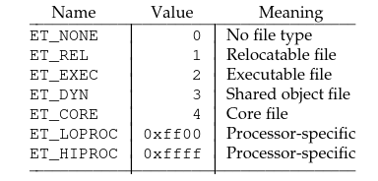
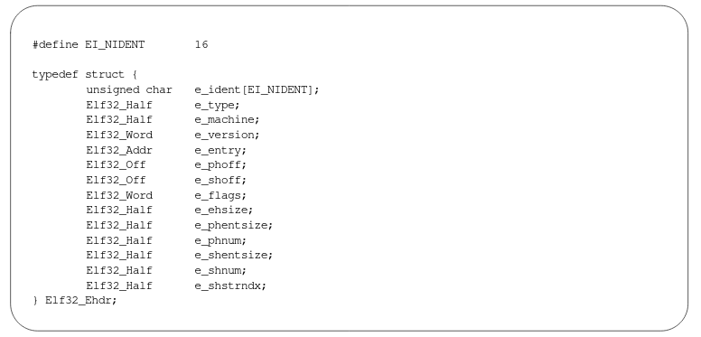
ELF Headers
e_type
Program entry point virtual address
e_entry

Slide 7
Sections vs. Segment
Object file != executable file
But they’re both ELFs
Sections are chunks of programs we move around when linking
Segments are how chunks of programs are loaded into memory
No explicit mapping between sections and segments
Both section table and segment table point into the overall contents
Need to maintain memory permissions
To see mapping, run `readelf -l`
Notes:
Sections ignored in executable
Segments ignored in object files

Slide 8
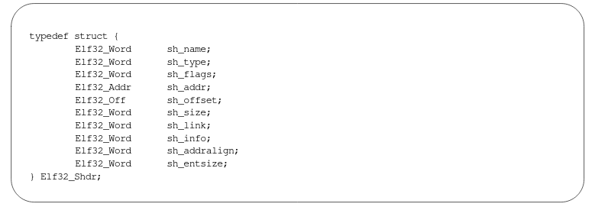
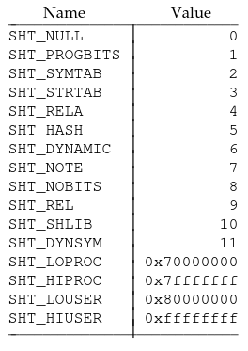
Sections
Metadata stored in section table
`sh_type`
`sh_flags` - permissions
Some sections have no runtime effect: SHT_NOTE
SHT_NOBITS - .bss

Slide 9
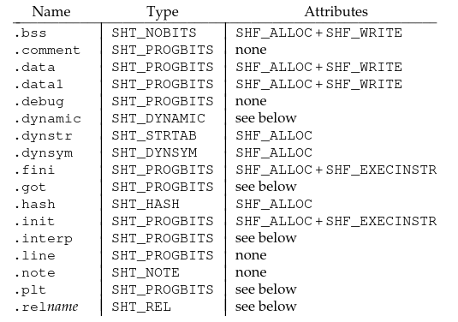
Common Sections

Slide 10
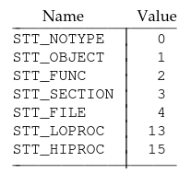
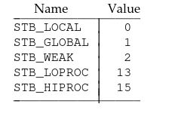
Symbols
`st_name` - index into strtab
`st_info` - symbol type, binding
STB_LOCAL
STB_GLOBAL
STB_WEAK

Slide 11
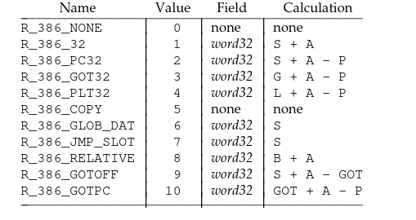
Relocations
How do we safely move sections around?

Slide 12
Segments

Slide 13
How does PIE work?

